Slide 1
Development of master curricula for natural disasters risk management in Western Balkan countries
Application of UAVs in case of natural disasters
Arnold Őszi
OE BGK
Second Session - Laboratories/23rd May 2017
Project number: 573806-EPP-1-2016-1-RS-EPPKA2-CBHE-JP
"This project has been funded with support from the European Commission. This publication reflects the views only of the author, and the Commission cannot be held responsible for any use which may be made of the information contained therein"
Notes:
N.143

Slide 2
Schedule
Development of master curricula for natural disasters risk management in Western Balkan countries
Application of UAVs in case of natural disaster
The basics of UAVs
Laboratory work

Slide 3
UAVs in case of natural disaster
Development of master curricula for natural disasters risk management in Western Balkan countries
Notes:
Earthquake
Some areas are hard to approach

Slide 4
UAVs in case of natural disaster
Development of master curricula for natural disasters risk management in Western Balkan countries
Notes:
Earthquake
Some areas are hard to approach

Slide 5
UAVs in case of natural disaster
Development of master curricula for natural disasters risk management in Western Balkan countries
Notes:
Forest fire
Fire core
To determine the extension of the fire
UAV is cheaper (to buy and operate), faster (to take off) and more safe, more stable than an airplane or helicopter

Slide 6
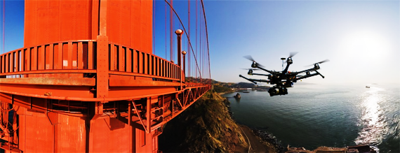
UAVs in case of natural disaster
Development of master curricula for natural disasters risk management in Western Balkan countries
Bridge inspections
Notes:
Instead of industrial alpinist

Slide 7
UAVs in case of natural disaster
Development of master curricula for natural disasters risk management in Western Balkan countries
Notes:
Pylon
Electric transmission line

Slide 8
UAVs in case of natural disaster
Development of master curricula for natural disasters risk management in Western Balkan countries
Notes:
Zoom function

Slide 9
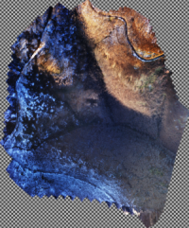
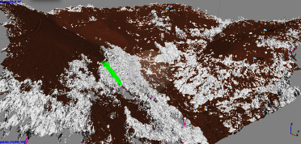
UAVs in case of natural disaster
Development of master curricula for natural disasters risk management in Western Balkan countries
Field mapping - aerial photo, orthophoto, 3D modeling - with georeference
Notes:
There are mountains, forest roads and valleys where it is impossible to get to even after a month because of fallen trees and deep mud.

Slide 10
UAVs in case of natural disaster
Development of master curricula for natural disasters risk management in Western Balkan countries

Slide 11
UAVs in case of natural disaster
Development of master curricula for natural disasters risk management in Western Balkan countries

Slide 12
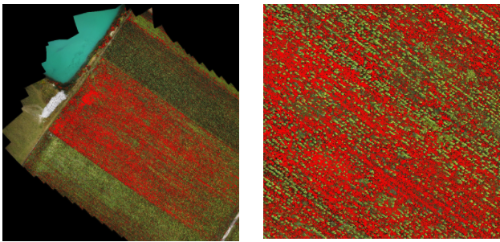
UAVs in case of natural disaster
Development of master curricula for natural disasters risk management in Western Balkan countries
Sunflower – Rugweed – 40%

Slide 13
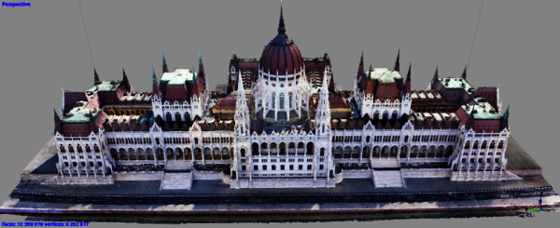
UAVs in case of natural disaster
Development of master curricula for natural disasters risk management in Western Balkan countries
750 photos – less than 10cm accuracy
10,000 photos – less than 1cm accuracy
Notes:
3D modelling
Cracks, holes, missing objects.

Slide 14
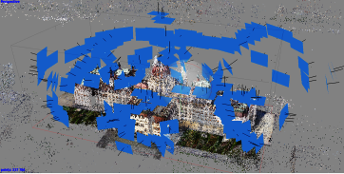
UAVs in case of natural disaster
Development of master curricula for natural disasters risk management in Western Balkan countries
Small model
Sparse point mesh
Dense mesh
Creating the mesh/surface
Textures

Slide 15
UAVs in case of natural disaster
Development of master curricula for natural disasters risk management in Western Balkan countries
Notes:
Use of thermal camera’s

Slide 16
UAVs in case of natural disaster
Development of master curricula for natural disasters risk management in Western Balkan countries
Notes:
Use of thermal camera’s
Part of the building is heated

Slide 17
UAVs in case of natural disaster
Development of master curricula for natural disasters risk management in Western Balkan countries
Notes:
Use of thermal camera’s

Slide 18
UAVs in case of natural disaster
Development of master curricula for natural disasters risk management in Western Balkan countries
Notes:
Use of thermal camera’s

Slide 19
UAVs in case of natural disaster
Development of master curricula for natural disasters risk management in Western Balkan countries
Notes:
Use of thermal camera’s

Slide 20
UAVs in case of natural disaster
Development of master curricula for natural disasters risk management in Western Balkan countries
Notes:
Use of thermal camera’s at night

Slide 21
UAVs in case of natural disaster
Development of master curricula for natural disasters risk management in Western Balkan countries
Notes:
Transporting any cargo

Slide 22
Definitions
Development of master curricula for natural disasters risk management in Western Balkan countries
UAV is an unmanned aerial vehicle (an aircraft piloted by remote control or onboard computers)
RPAS is a Remotely Piloted Aircraft System
Drone is an unmanned aircraft
Notes:
More drone definitions: http://www.dictionary.com/browse/drone

Slide 23
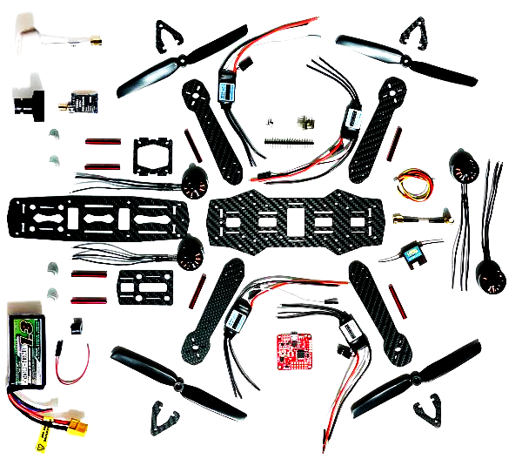
Parts of an UAV
Development of master curricula for natural disasters risk management in Western Balkan countries
Frame
Landing gear
Blade
Motor
ESC
Battery
FC
FPV
Notes:
ESC (Electronic Speed Controller)
FC (Flight Controller)
FPV Camera
FPV Transmitter / Receiver
FPV Antenna
FPV Goggle / Monitor

Slide 24
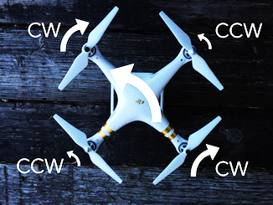
How an UAV works
Development of master curricula for natural disasters risk management in Western Balkan countries

Slide 25
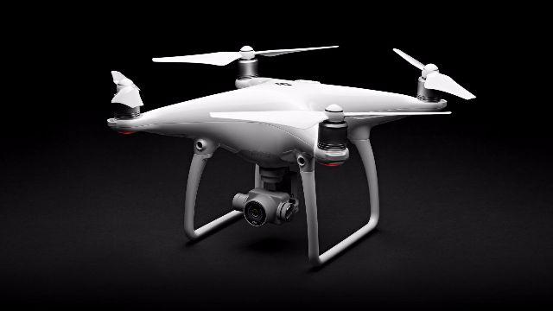
UAV
Development of master curricula for natural disasters risk management in Western Balkan countries
Notes:
A DJI Phantom UAV for aerial photography
Lots of sensors
Expensive
Easy to use
Like the iphone
You can not modify the structure

Slide 26
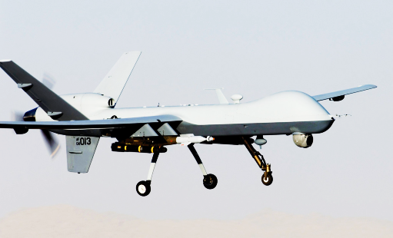
UAV
Development of master curricula for natural disasters risk management in Western Balkan countries
Notes:
A General Atomics MQ-9 Reaper, a hunter-killer surveillance UAV

Slide 27
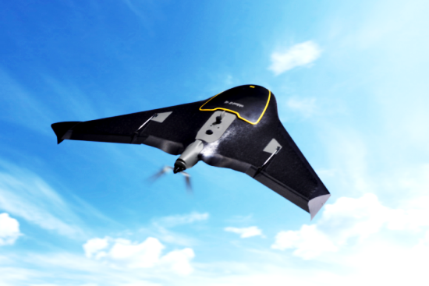
UAV
Development of master curricula for natural disasters risk management in Western Balkan countries
Notes:
This is not a cargo
It can fly longer distances
Can not hower
Difficult to take off and land

Slide 28
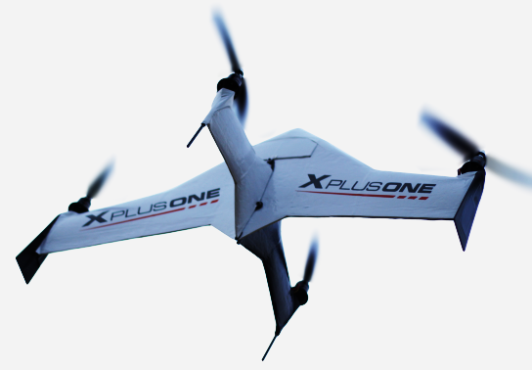
UAV
Development of master curricula for natural disasters risk management in Western Balkan countries
Notes:
Expirimental

Slide 29
UAV
Development of master curricula for natural disasters risk management in Western Balkan countries
Notes:
Professional use
Foldable arms
Retractable Landing Gear
Weighing just 4.4kg, the S1000+ has a maximum takeoff weight of 11kg
it can fly for up to 15 minutes.

Slide 30
UAV (Tailwind)
Development of master curricula for natural disasters risk management in Western Balkan countries
Gasoline / Petrol
Range 250km
Max playload: 3kg
Flight time: 4.5h, with 1kg cargo: 3.5h
Max velocity: 56km·h−1

Slide 31
UAVs in civil use
Development of master curricula for natural disasters risk management in Western Balkan countries
Ad hoc airspace
30 days -> 3 days from 2017 January
Hungarocontrol smartphone app
Flight plan before takeoff
Weather conditions (wind and rain)
Notes:
Ad hoc airspace is for UAV-s, parachute jumps, fireworks
Only a few company requires airspace

Slide 32
Vespadrones XYRIS 7
Development of master curricula for natural disasters risk management in Western Balkan countries
Notes:
It is a modifiable UAV, we can install differet instruments, it is the best in case of a natural disaster
Carbon fiber composite
Shields the electromagnetic space
Stronger and lighter than steel

Slide 33
Vespadrones XYRIS 7
Development of master curricula for natural disasters risk management in Western Balkan countries
Number of engines 6
Motor failure redundancy
Maximum power 6 x 700W
Hover power input: 1100 W
Propeller diameter 17”
Height - Operational: 578 mm
Width - Operational: 1430 mm
Depth - Operational: 1293 mm

Slide 34
Vespadrones XYRIS 7
Development of master curricula for natural disasters risk management in Western Balkan countries
Flight conditions – temperature: -5°C to +40°C
Flight conditions - wind resistance up to: 8 m·s−1
Flight conditions – No rain
Max. altitude a.s.l.: 2500m / 6500ft
Battery type Li-Pol 6-Cell
Battery capacity: 16 000 mAh
Notes:
Li-Po is the most used battery
They are in serial connection under the coverage

Slide 35
Vespadrones XYRIS 7
Development of master curricula for natural disasters risk management in Western Balkan countries
Empty weight (no battery): 4 100g
Typical takeoff weight: 7 300g
Typical payload (Gimbal + Workswell Light System): 1200g
Battery weight: 1900g
Maximal takeoff weight: 9 500g
Maximal payload: 3 000g
Notes:
These are very tipical parameters

Slide 36
Vespadrones XYRIS 7
Development of master curricula for natural disasters risk management in Western Balkan countries
Empty flight time (hover/combined): 32 / 25 min
Typical flight time (hover/combined): 26 / 20 min
Max. payload flight time (hover/combined): 15 / 15 min
Horizontal speed: 0 - 14 m·s−1 (50km·h−1)
Vertical speed up to (ascent / descent): 6 / 2 m·s−1
Notes:
These are very tipical parameters
This flight time is enough for most of the missions.
The max speed for multicopters is above 100 kmph
Descnet speed is low, because of the turbulence

Slide 37
Vespadrones XYRIS 7
Development of master curricula for natural disasters risk management in Western Balkan countries

Slide 38
Vespadrones XYRIS 7
Development of master curricula for natural disasters risk management in Western Balkan countries
Notes:
It has 6 cells
It requires balanced charging
Full charge is an hour
We have 3 batteries, it is an hour flight time

Slide 39
Vespadrones XYRIS 7
Development of master curricula for natural disasters risk management in Western Balkan countries
Advanced multi-purpose hexacopter
Retractable landning gear
DJI Wookong-M professional flight controller
Altitude controlled assisted flight / GPS position controlled assisted flight /Autonomous flight
Real-time voltage telemetry + low power warning and failsafe
Ground station telemetry module
Notes:
GPS stabilisation
Flight modes

Slide 40
Vespadrones XYRIS 7
Development of master curricula for natural disasters risk management in Western Balkan countries

Slide 41
Vespadrones XYRIS 7
Development of master curricula for natural disasters risk management in Western Balkan countries

Slide 42
UAVs in case of natural disaster
Development of master curricula for natural disasters risk management in Western Balkan countries
Radio - Type HiTec Aurora 9
Radio - Frequency 2.4 GHz
Radio – Range: 1000m+ / 3300ft+
FPV - Type FatShark 250mW
FPV - Frequency 5.8 GHz
FPV – Range: 500m+ / 1300ft+

Slide 43
Vespadrones XYRIS 7
Development of master curricula for natural disasters risk management in Western Balkan countries

Slide 44
Vespadrones XYRIS 7
Development of master curricula for natural disasters risk management in Western Balkan countries
Failsafe in case of signal loss (Go Home at preset altitude)

Slide 45
Vespadrones XYRIS 7
Development of master curricula for natural disasters risk management in Western Balkan countries

Slide 46
Vespadrones XYRIS 7
Development of master curricula for natural disasters risk management in Western Balkan countries
Notes:
Dual antenna
Dedicated battery

Slide 47
Vespadrones XYRIS 7
Development of master curricula for natural disasters risk management in Western Balkan countries
Analog video transmission to ground-based LCD
3-axis 360° view (continuous rotation) brushless gimbal with remote control
OSD video overlay with important flight data
Workswell Thermal Vision Light system

Slide 48
Vespadrones XYRIS 7
Development of master curricula for natural disasters risk management in Western Balkan countries
Notes:
OSD

Slide 49
Vespadrones XYRIS 7
Development of master curricula for natural disasters risk management in Western Balkan countries
Notes:
Thermal camera

Slide 50
Vespadrones XYRIS 7
Development of master curricula for natural disasters risk management in Western Balkan countries
Notes:
Adventage of the 2 camera

Slide 51
Vespadrones XYRIS 7
Development of master curricula for natural disasters risk management in Western Balkan countries

